Slide 1
Loading Transaction Data using DSO
Milind Parab

Slide 2
Pre-Requisites for the Demo.
Load Master Data.
Create Flat File Transaction Data.
Create Info Objects.
SMID : SIDxx
PID: PIDxx
Quantity: QTY_xx
Sales: SREV_xx
Profit: PR_xx

Slide 3
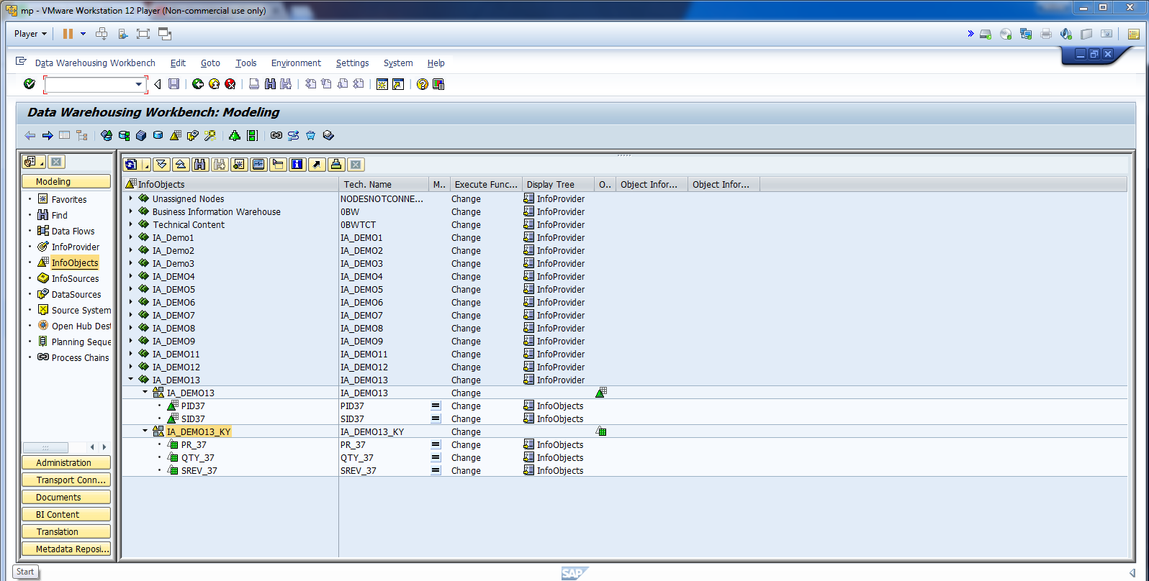
Pre-Requisites.

Slide 4
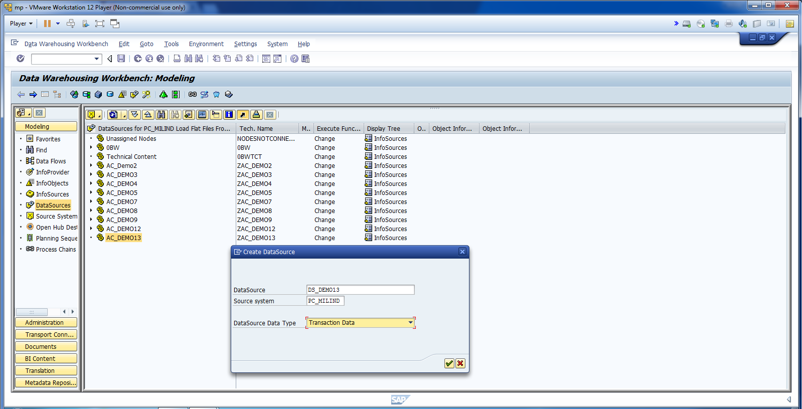
Create Data Source.

Slide 5
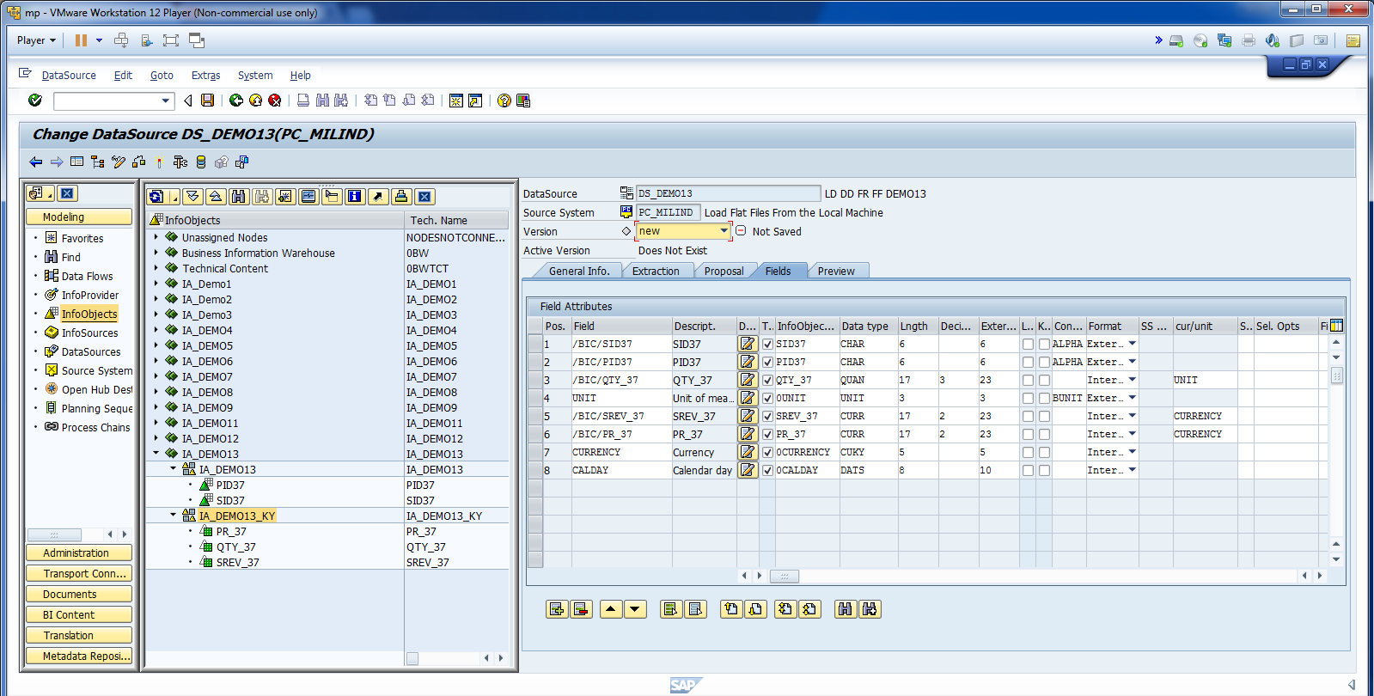
Map all fields and activate.

Slide 6
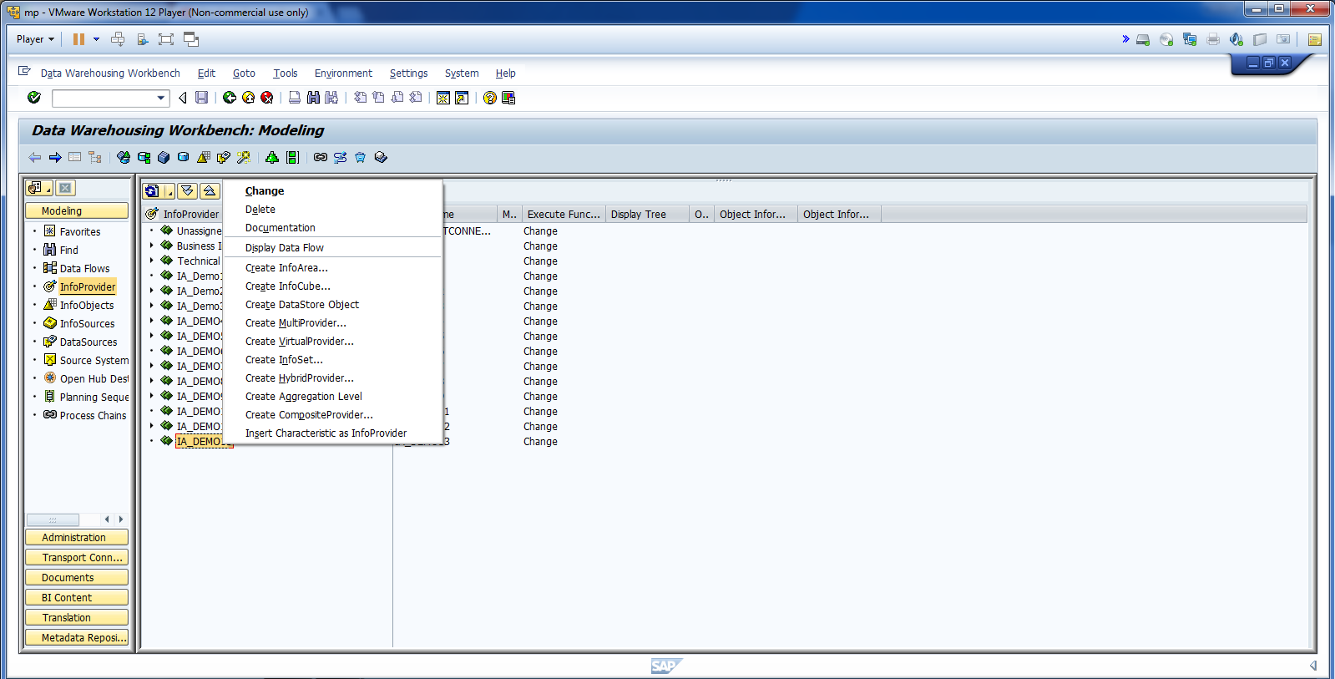
Create DSO.

Slide 7
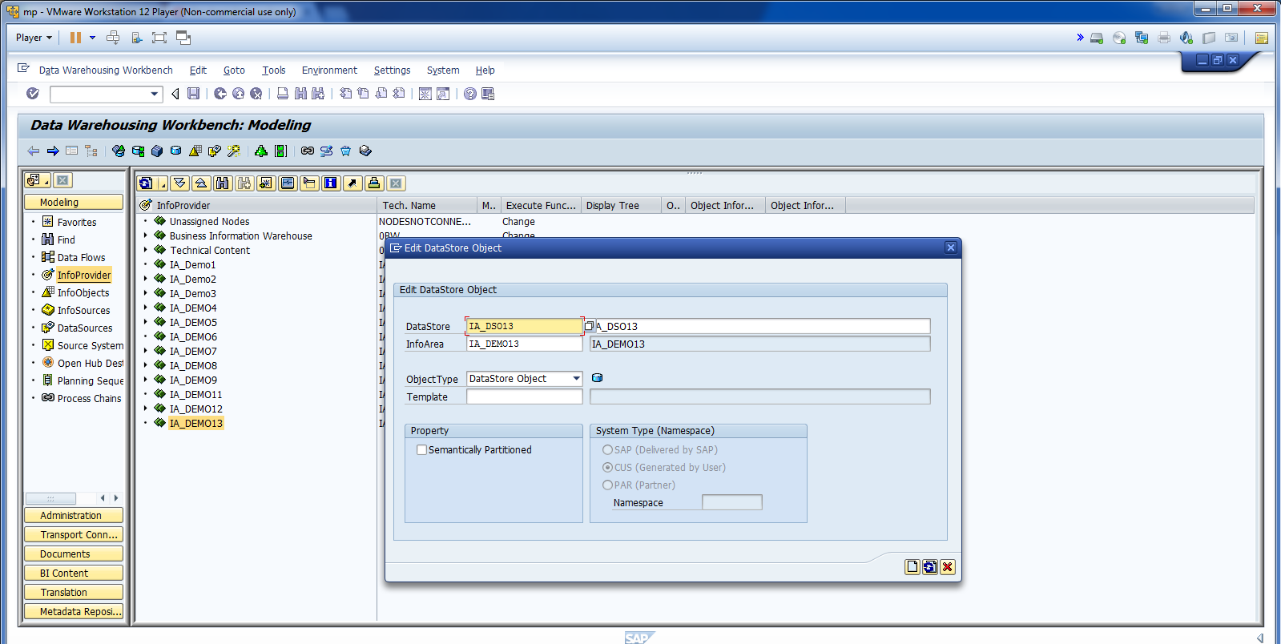
Cont.

Slide 8
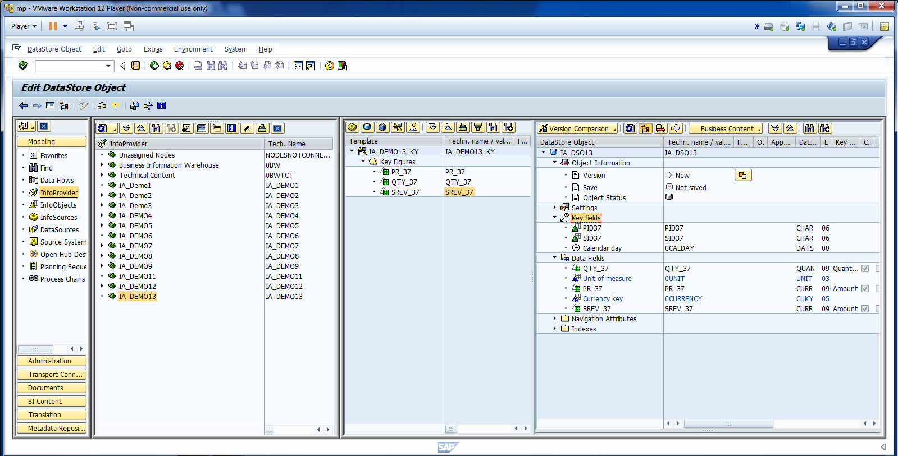
Cont.

Slide 9
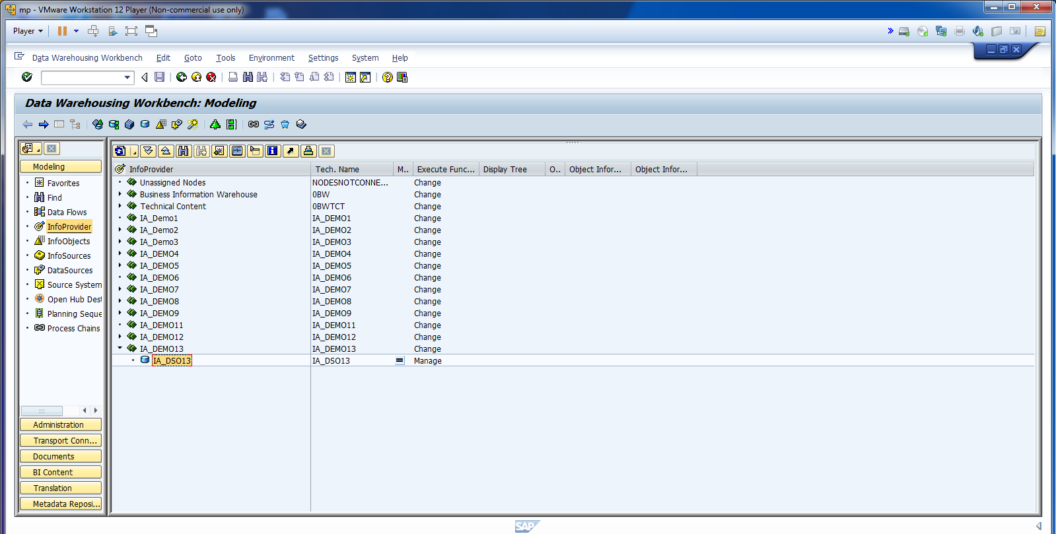
Activate DSO.

Slide 10
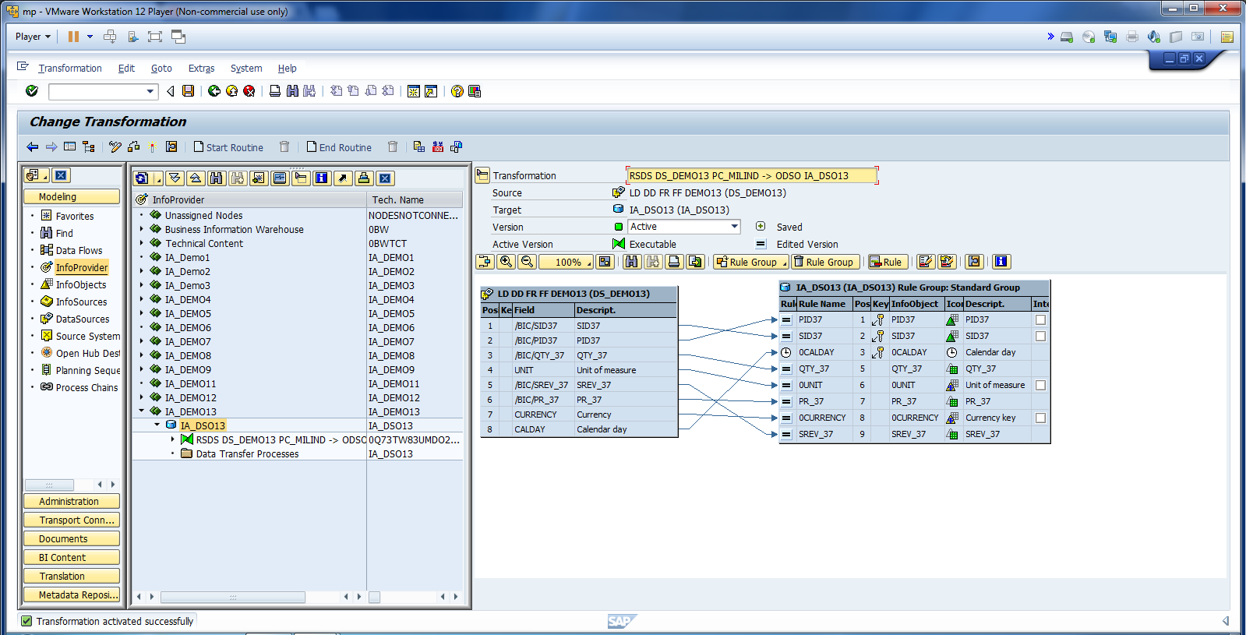
Cont.

Slide 11
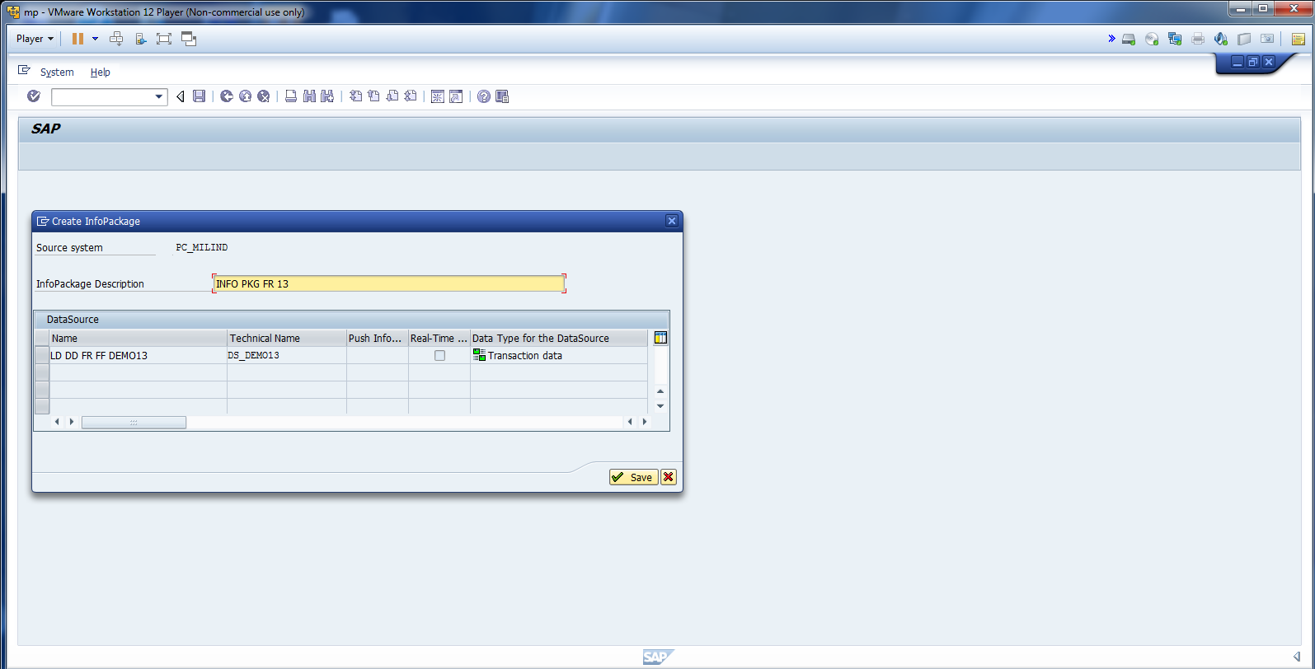
Cont.

Slide 12
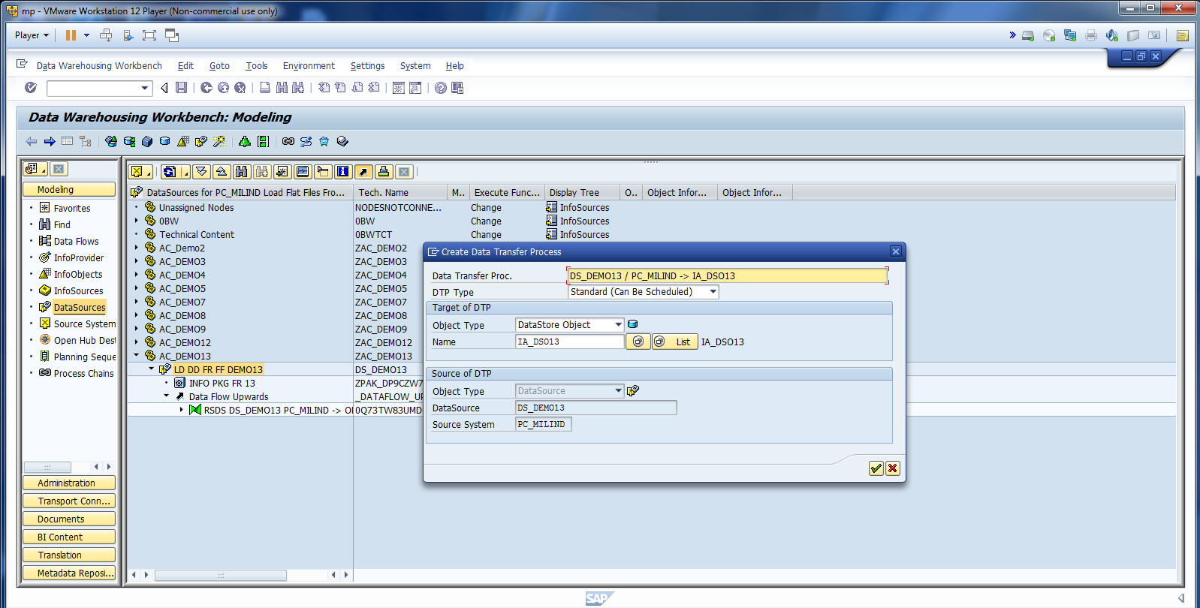
Create DTP.

Slide 13
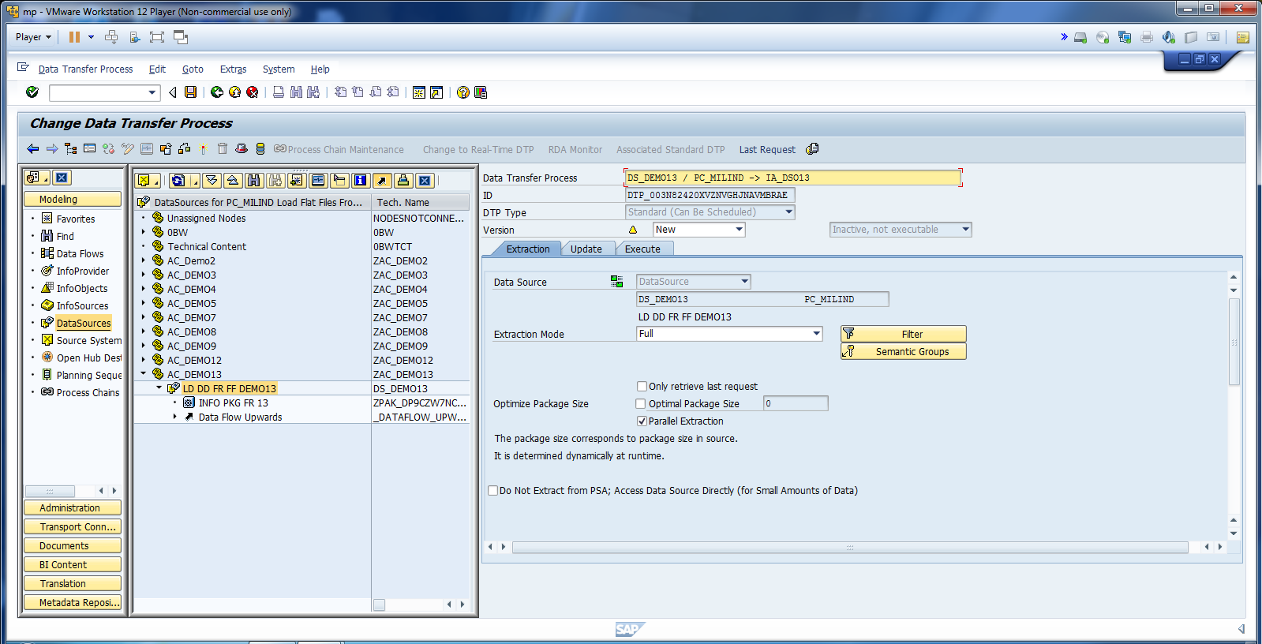
Cont.

Slide 14
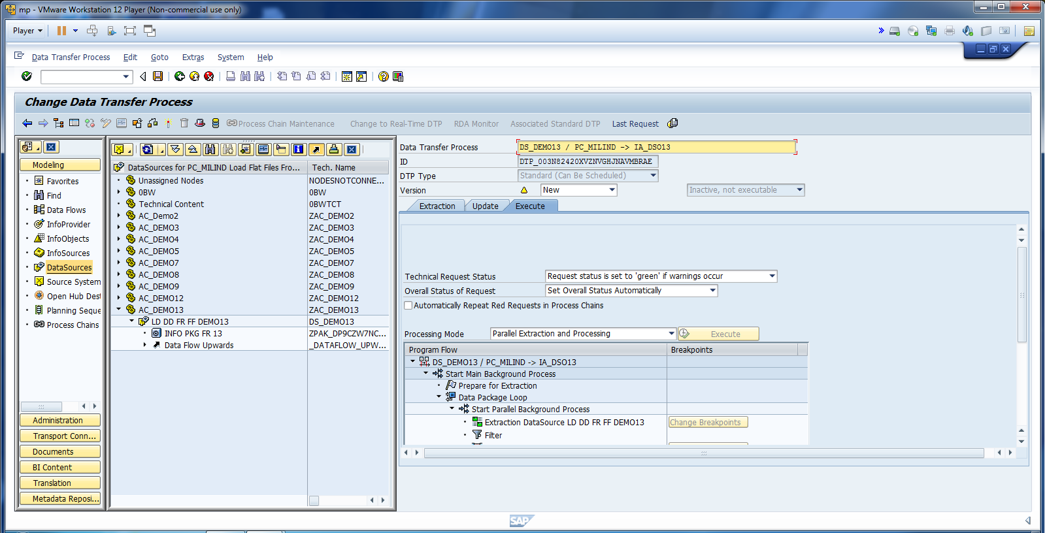
Activate DTP.

Slide 15
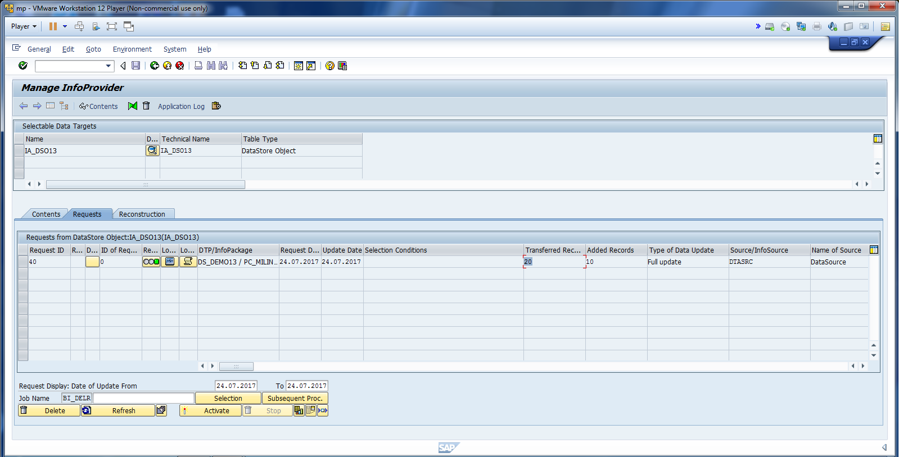
Go to Administrator Data Target.

Slide 16
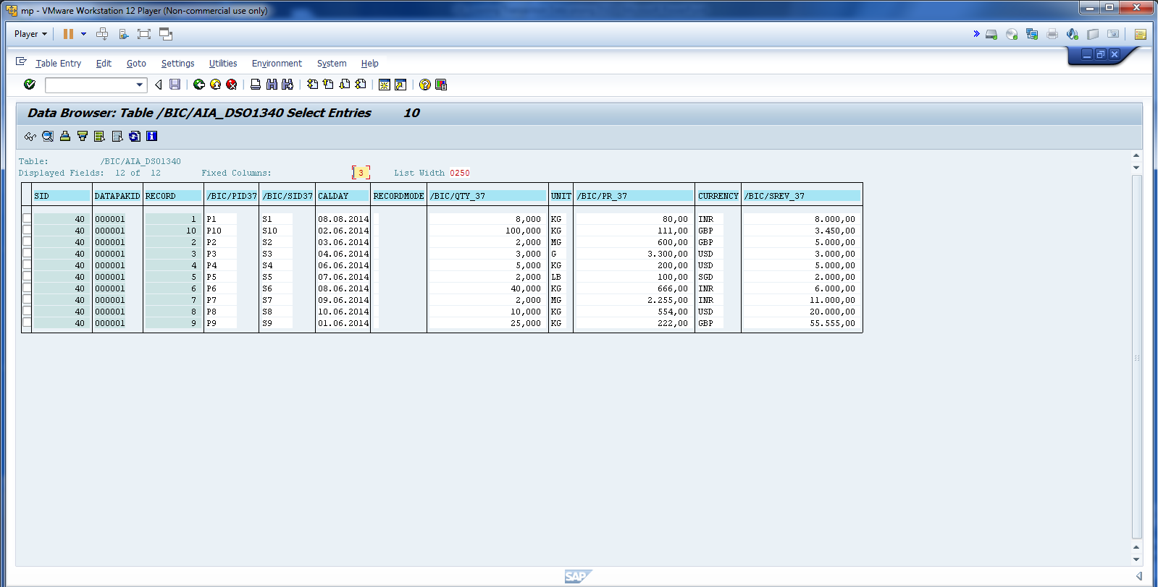
Data is available in New Data Table.

Slide 17
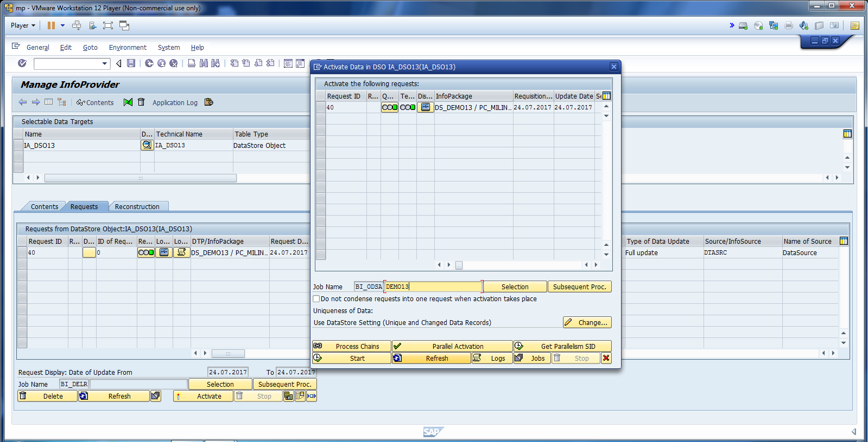
Enter Job Name and Click Start.

Slide 18
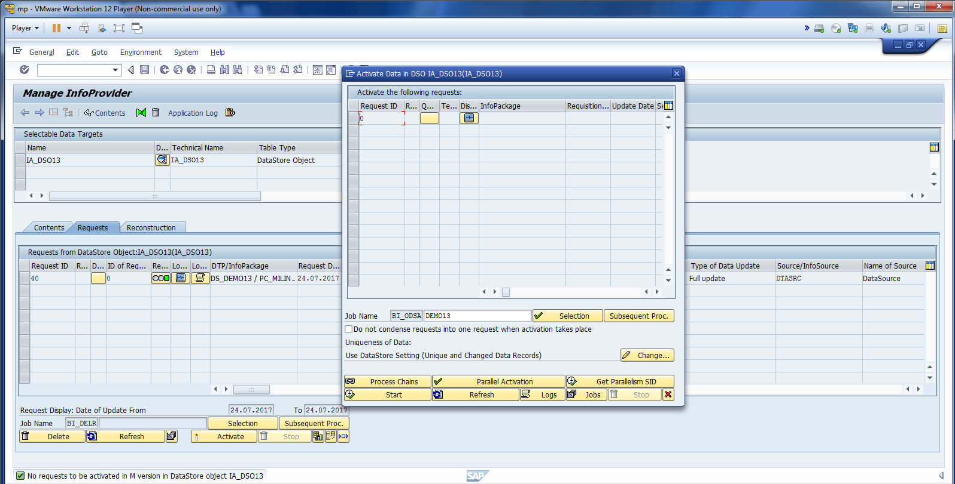
Once the request is gone, data is ready for reporting.

Slide 19
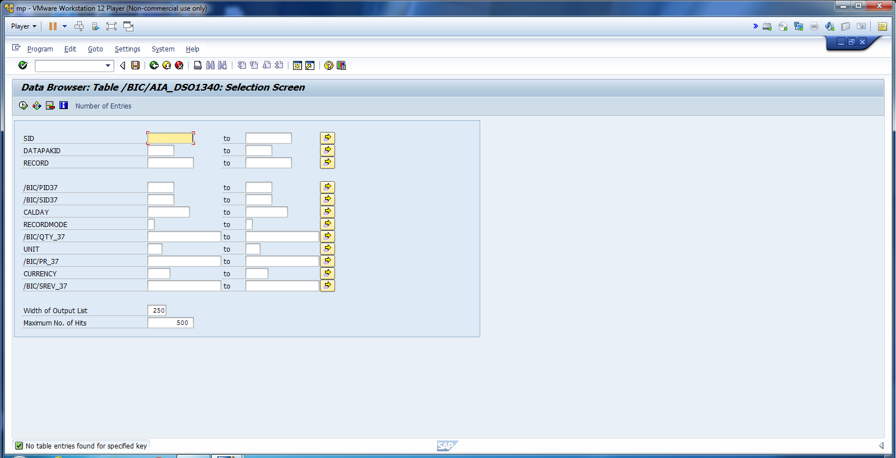
Check data in new data table.

Slide 20
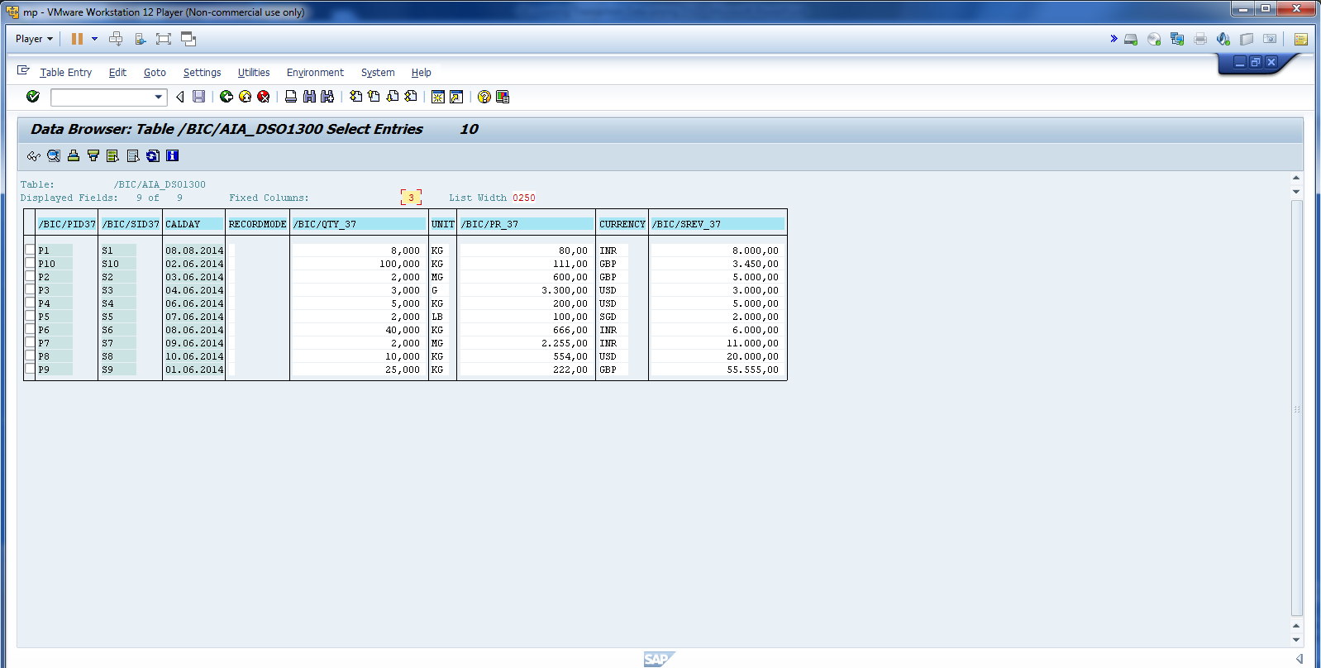
Check the data in Active Data Table.

Slide 21
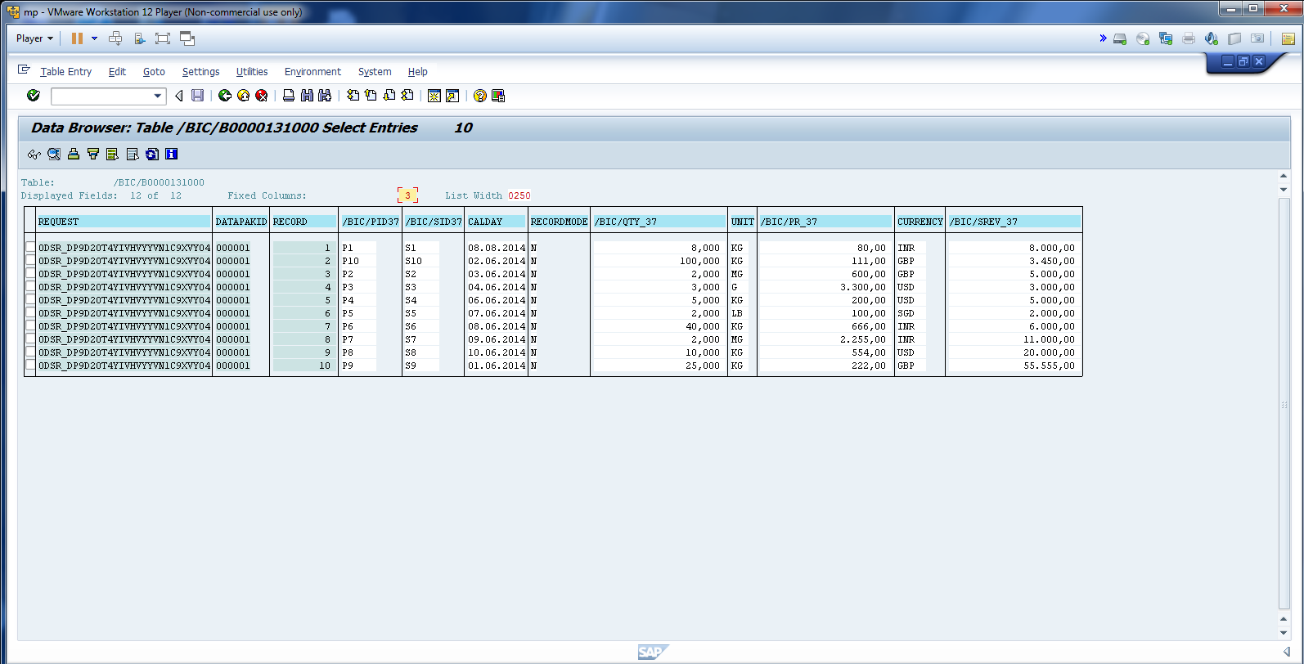
Also, same data moved to change log table.

